Slide 1
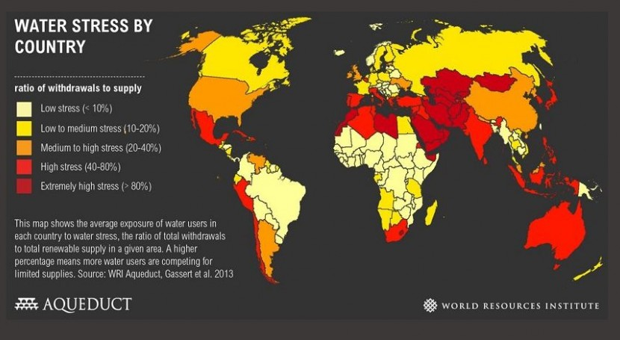

Slide 2
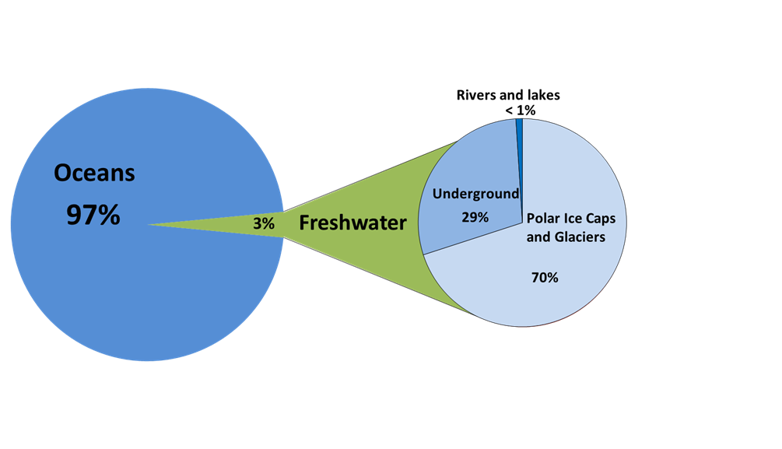
The Composition of the Planet’s Water
The power of water
Water connects every aspect of life. Access to safe water and sanitation can quickly turn problems into potential – empowering people with time for school and work, and contributing to improved health for women, children, and families around the world.
Today, 1 in 9 people lack access to safe water and 1 in 3 people lack access to a toilet.

Slide 3
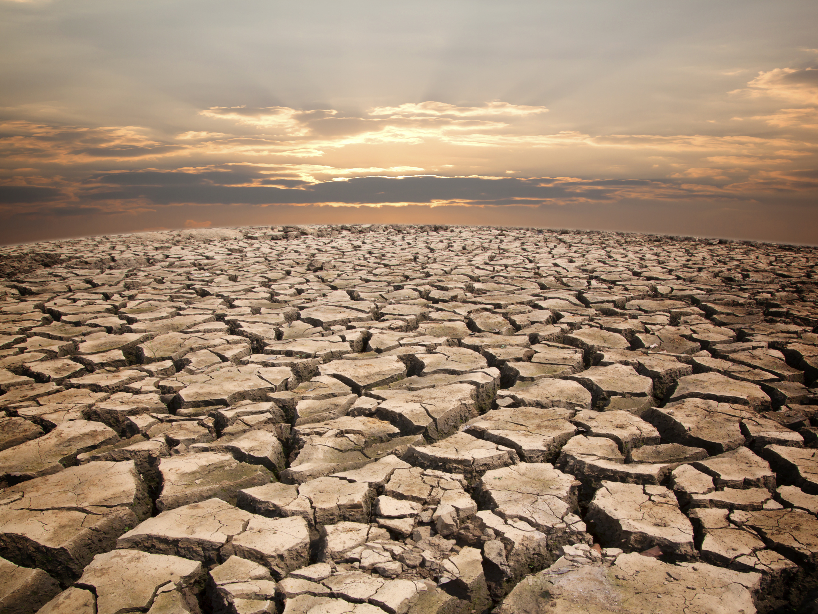
WATER SCARCITY
WHAT IS IT ?
Water scarcity is the lack of fresh water resources to meet water demand. It affects every continent and was listed in 2015 by the World Economic Forum as the largest global risk in terms of potential impact over the next decade
FACTS ABOUT WATER CRISIS
1) 844 million people lack basic drinking water access, more than 1 of every 10 people on the planet.
2) Women and girls spend an estimated 200 million hours hauling water every day.
3) The average woman in rural Africa walks 6 kilometers every day to haul 40 pounds of water.
4) Every day, more than 800 children under age 5 die from diarrhea attributed to poor water and sanitation.
6) 2.3 billion people live without access to basic sanitation.
7) 1 billion people practice open defecation.
90 percent of all natural disasters are water-related.

Slide 4
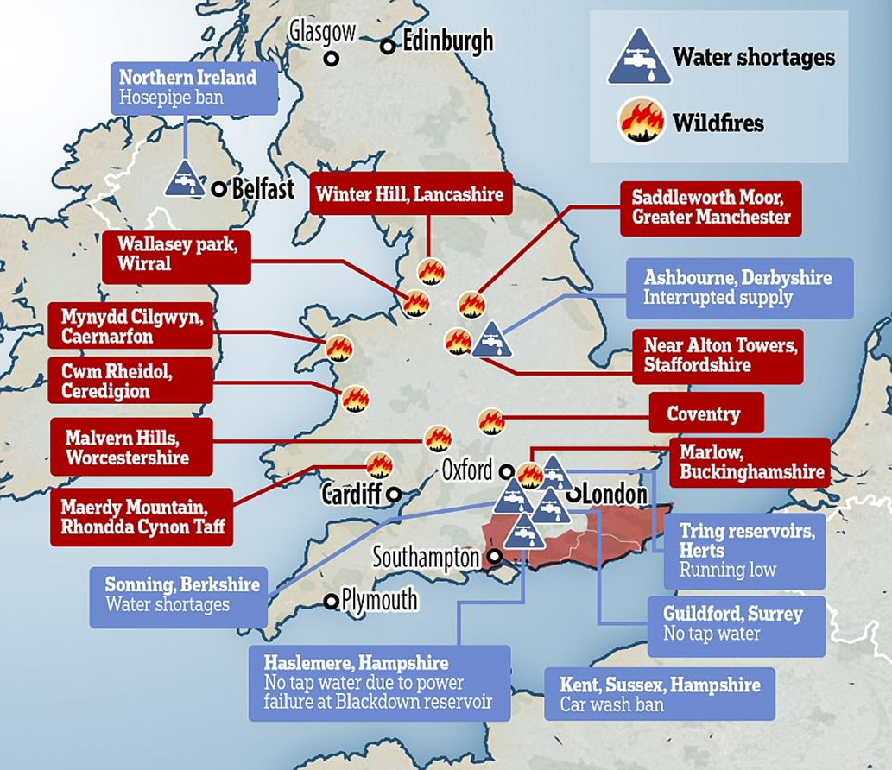
Water Crisis IN UK
Many sources of water supplies are already overstretched and, with climate change and a growing population, much of England could see significant supply shortages by the 2050s – particularly in the south-east.
In England, almost 9,500bn litres of freshwater were abstracted in 2016, which is enough to cover the whole of Greater London in nearly 6m (20ft) of water, the EA said in a new report.
But 3bn litres a day are lost through leaks from pipes – equivalent to the amount of water used by more than 20 million people in an average day.
Large amounts of water are also wasted by households, where average use is 140 litres per person a day. In total, a third of water taken from the natural environment is wasted through leaks, treatment losses, and in the home.
The amount of water taken out of the environment for households, industry and agriculture was already unsustainable for more than a quarter (28%) of groundwater resources in 2017, and almost a fifth (18%) of surface water such as rivers have also seen unsustainable levels of abstraction.
That meant that somewhere between 6% and 15% of rivers were in a poor environmental condition, including more than three-quarters of chalk streams – a unique and globally important habitat.
At a national scale, England, Scotland and Wales are projected to be in deficit by 800 million to 3 billion litres per day by 2050 (5–16% of total demand) and by 1.4 billion to 5 billion litres per day by 2080 (8-29% of the total demand).
MAP SHOWING WATER SHORTAGES

Slide 5
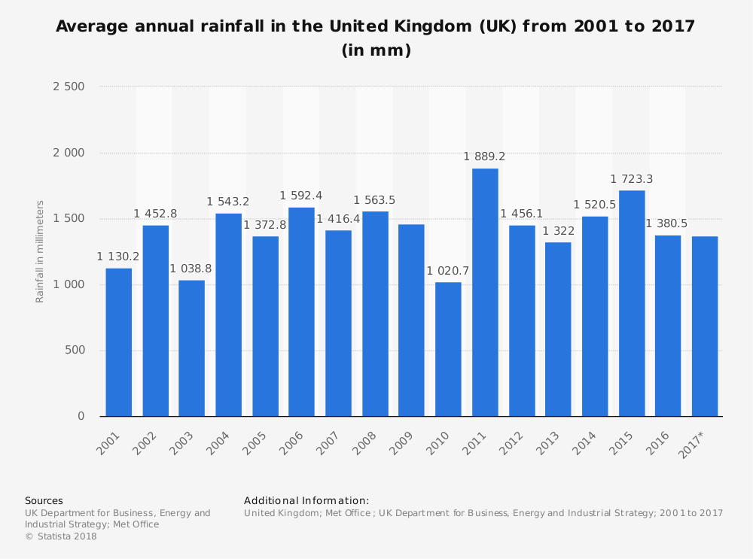
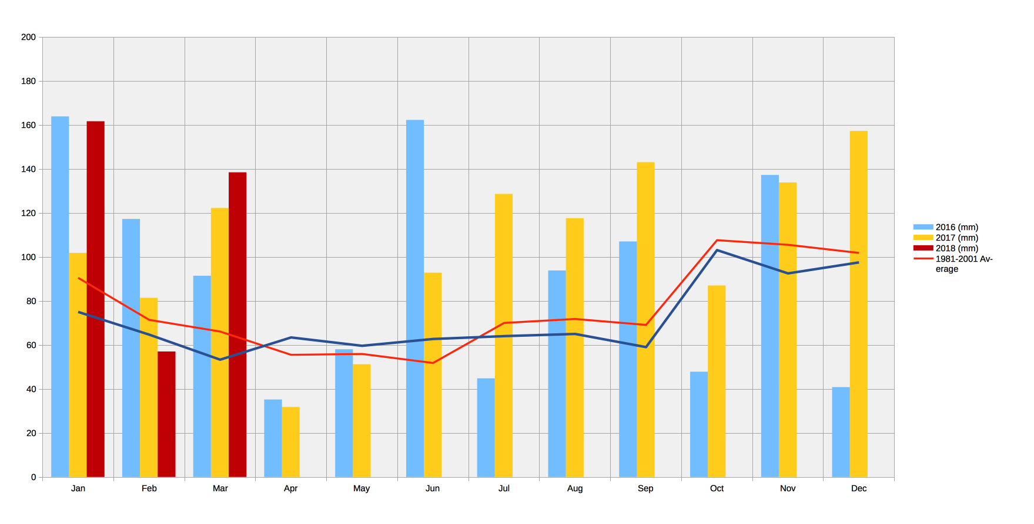
RAINFALL LEVEL DECREASING
IN 2018

Slide 6
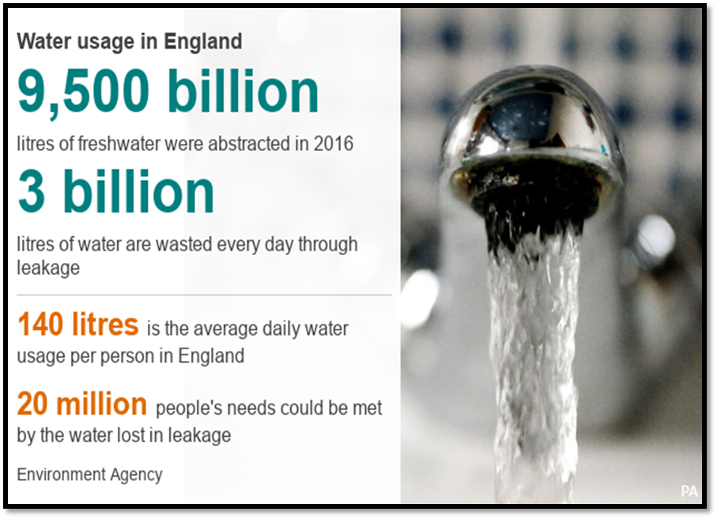
WHAT IS UK DOING ??
There are 24 water companies in England and Wales regulated by Ofwat. Companies are responsible for monitoring and controlling the water they supply to their customers. By law, all companies must produce a Water Resource Management Plan to forecast supply and demand in their area and explain how they plan to deliver secure public water supplies for at least the next 25 years.
When there is a drought, water companies implement Drought Plans which include a series of actions to ensure water resources are effectively managed. This includes, for example, temporary restrictions on water use (e.g. hosepipes, sprinkler systems, and swimming pools), allowing more water to be taken from rivers, and transferring water from other regions.
Reducing water-energy nexus pressures: The coastline of the region stretches for around 1,000 miles making energy efficient desalination a possibility to meet future water demand
Industrial water recycling: Water used in industrial processes can be reclaimed for storage and reuse for the same purpose, for agricultural irrigation, or even domestic purposes (flushing toilets, outdoor taps etc.)

Slide 7
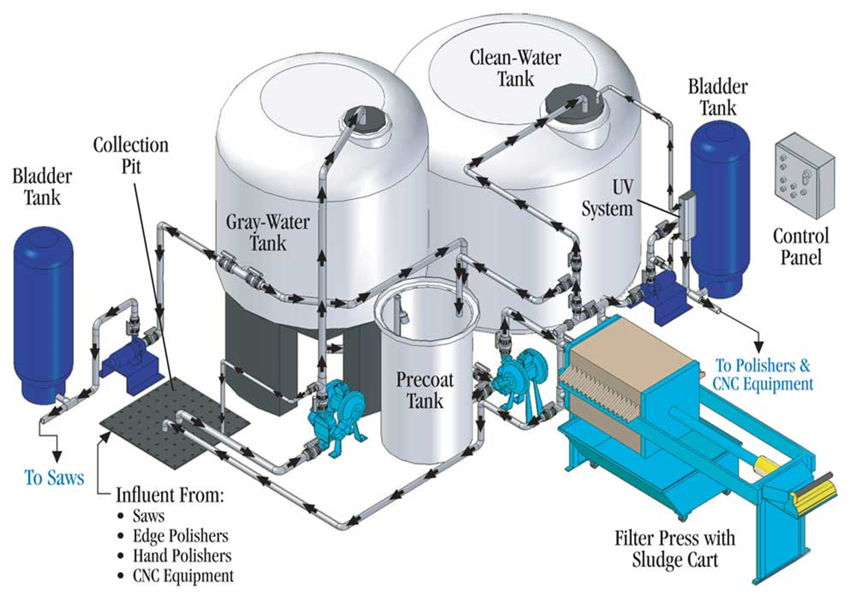
Uniting flood control and water supply: There is a possibility of working with drainage authorities and boards to change procedures from pumping away excess water to capturing it for use in the public water supply system
Natural infrastructure: WRE will explore the feasibility of directing excess flood water and overflow from new and existing dams and reservoirs to aquifers for use in times of high demand or drought.
Managing demand: WRE will focus on how to effectively engage customers on the need to conserve water, maximizing the potential outcomes of water demand approaches that include water conservation, using grey water, and installation of water-saving equipment
Water trading: WRE is exploring the possibility of developing transfer pipelines to share and transfer surplus water resources between companies and across sectors

Slide 8
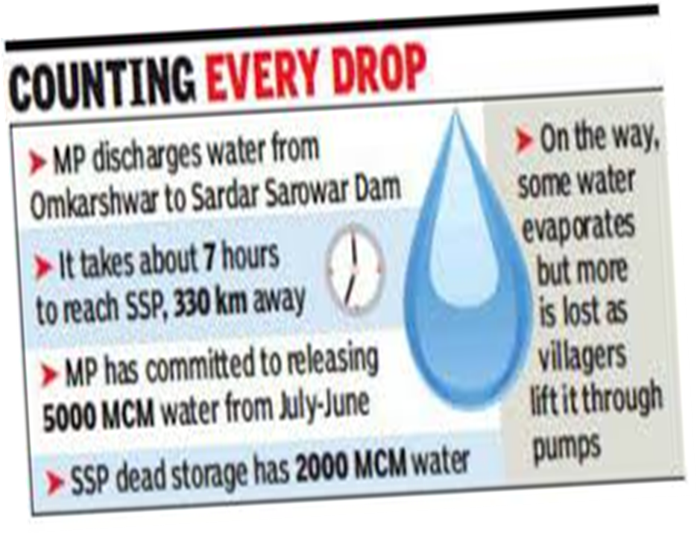
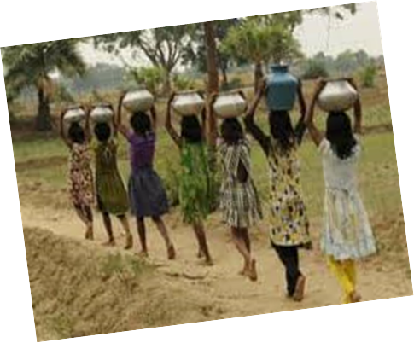
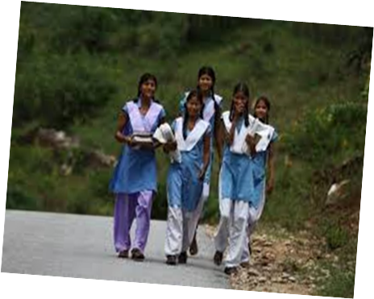
Water Crisis in Madhya Pradesh
The people of Madhya Pradesh's Satna district are facing acute water shortage. The villagers here are forced to walk almost three kilometres every day to collect groundwater for their basic needs as severe water crisis continues to make life miserable for people.
According to the locals in Satna's Ramnagar Khokhla, Tikuri Tola, Padmania and Dabri villages, many deaths occur every year as a result of this polluted water and only paperwork is provided in the name of water tankers by officials.
UNBELIEVABLE - Due to the problem of water scarcity in the Madhya Pradesh's Damoh district, the girls of government hostel have to travel four kilometers daily to use the toilet. The girls of the government hostel travel every day with their school teacher and other maids with buckets to use the toilet.

Slide 9
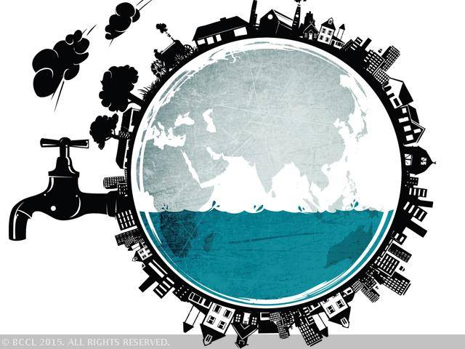
Solution to the Problems
Education: Educating the people of MP , about the situation of water crisis and how water can be effectively used as most of the population consist of uneducated people.
Setting up various organisations and companies which look after the problem of water crisis and find solutions to those problems.
Setting up industrial water recycling plants which would recycle the dirty water.
Forming policies and rules regarding water crisis .
Forming Strategies to overcome drought situations.
Recycle wastewater
Improve irrigation and agricultural practices
Develop energy efficient desalination plants
Population growth control

